Slide 1





SENSORED 9.0
ESP32 INTRO

Slide 2


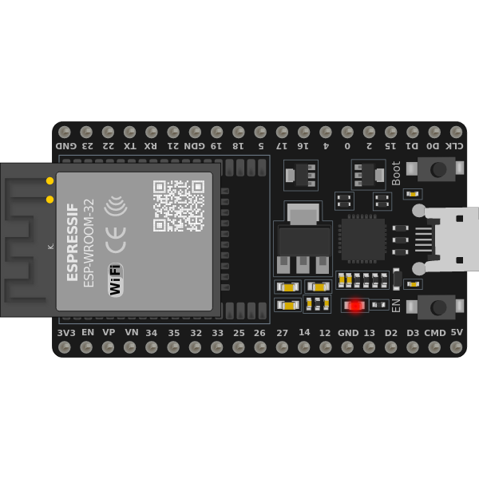
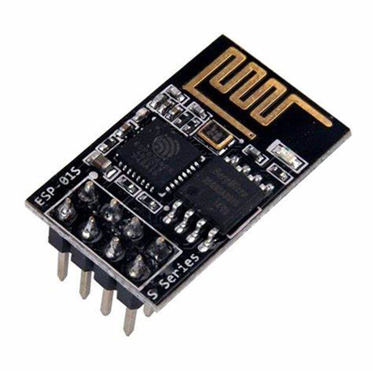
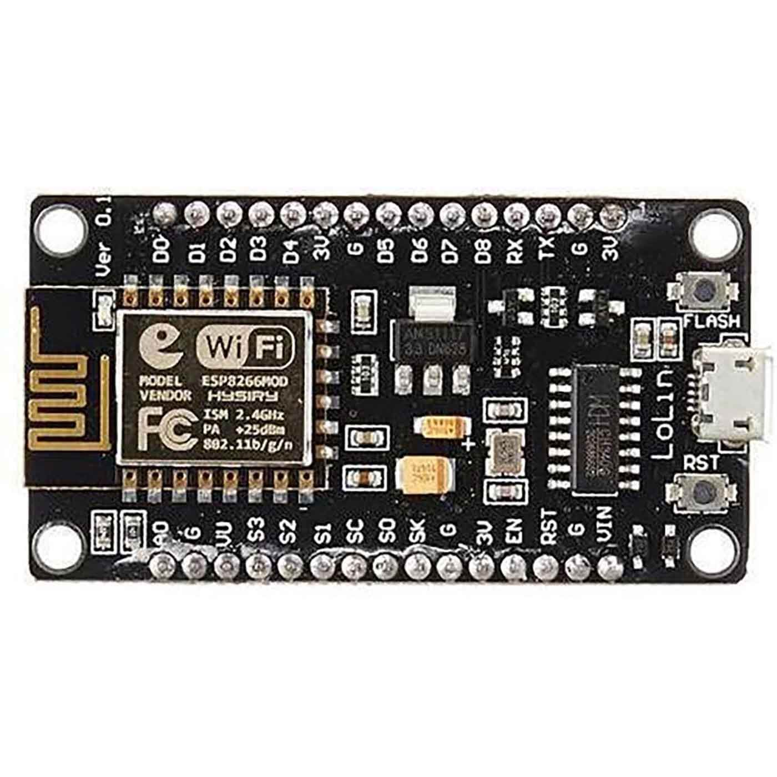
ESP8266
ESP - 32
ESP8266-01

Slide 3
ESP 32
The ESP-32 is a microcontroller chip developed by Espressif Systems.

Slide 4

ABOUT ESP 32
With the ESP-32, you can control inputs and outputs as you would do with an Arduino, but with Wi-Fi and Bluetooth capabilities.
Can generate its own Wi-Fi network (access point) or connect to other Wi-Fi networks (station) to get access to the internet.
Access point mode: It can create its own Wi-Fi network to which other devices can connect ( eg. Other ESP-32 , Mobile etc.) .
Station mode: It can be connected to any Wi-fi or Mobile hotspot.

Slide 5

IoT

Slide 6

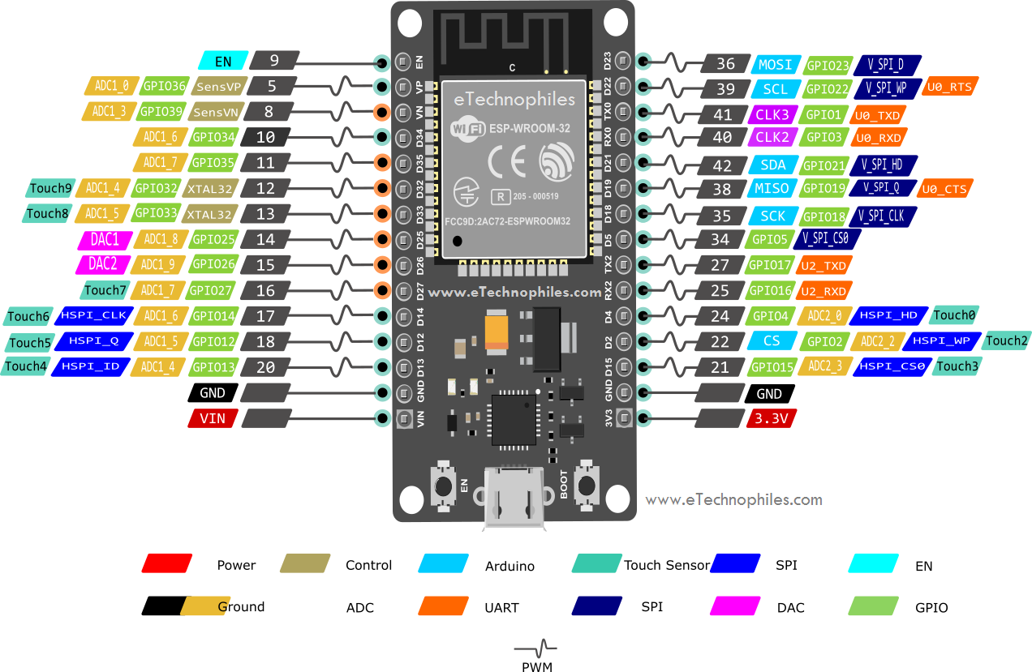
PIN DIAGRAM

Slide 7


Slide 8
PIN DIAGRAM
GPIO – General purpose I/O pin (25 Pins)
Vcc – Power supply ( 3.3V)
GND – Ground
Tx – Transmit pin for Serial Communication
Rx – Receiver pin for Serial Communication
EN – Chip enable pin. It must be pulled high (connected to VCC) for the module to function properly.
Reset pin – Resets the entire board.

Slide 9
SPECIFICATION
Power Supply: +3.6V only
Current Consumption: 100mA
I/O Voltage: 3.6V (max)
I/O current: 12mA (max)
Maximum data rate of up to 5 Mbps
ROM: 448 Kbyte
RAM: 520 KByte
Operates in 2.4 GHz , 5 GHz frequency band
Uses UART ,I2C ,SPI ,I2S protocols for data exchange

Slide 10
WHY ESP-32?
Can even go into deep sleep mode to consume less power.
ESP-32 can access online services to make HTTP requests or save data to the cloud.
you can access it using a web browser and be able to control and monitor your boards remotely.
Compatible with Arduino programming language and MicroPython which is a re-implementation of Python specially targeted for microcontrollers and embedded system.

Slide 11
INSTALLATION URL
https://dl.espressif.com/dl/package_esp32_index.json

Slide 12
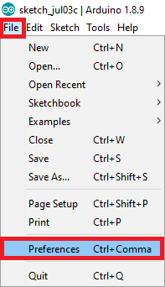
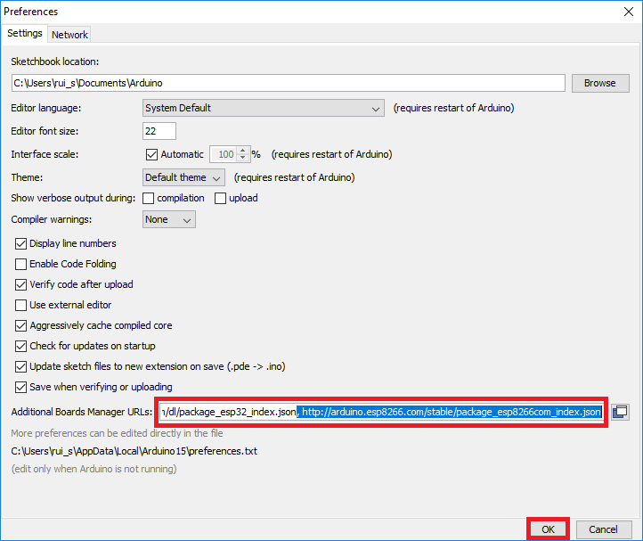
BOARD INSTALLATION PROCESS
STEP 1
STEP 2

Slide 13
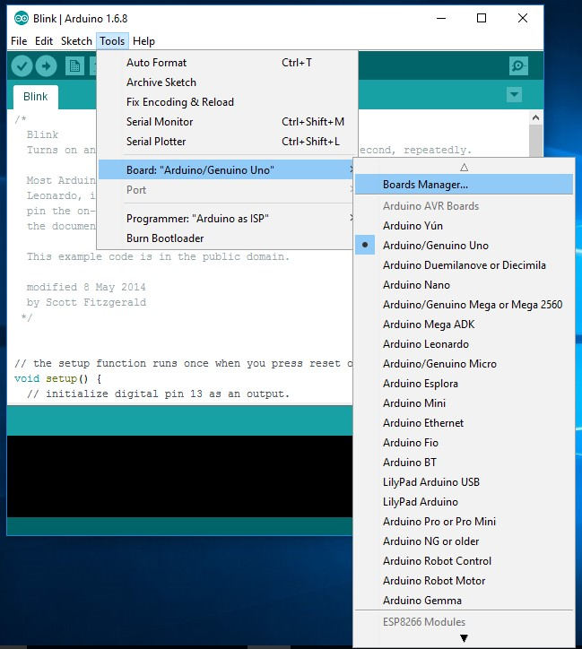
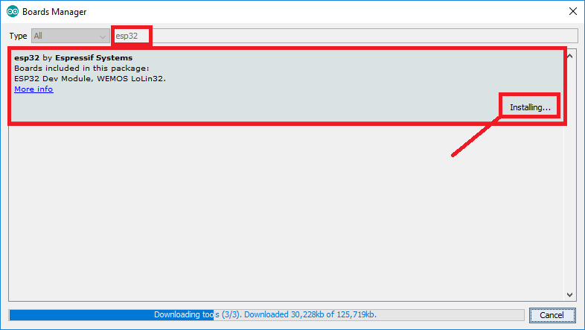
BOARD INSTALLATION PROCESS
STEP 4
STEP 3

Slide 14
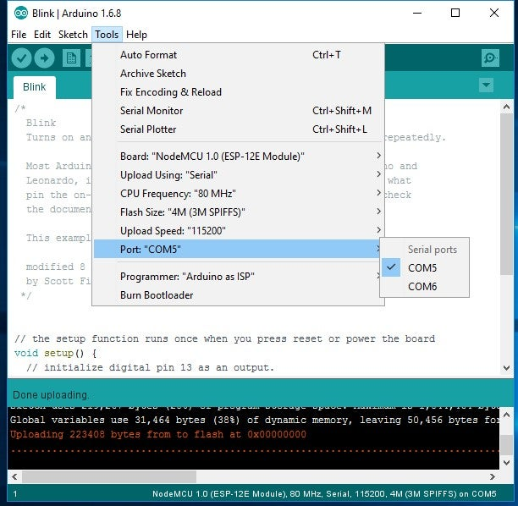
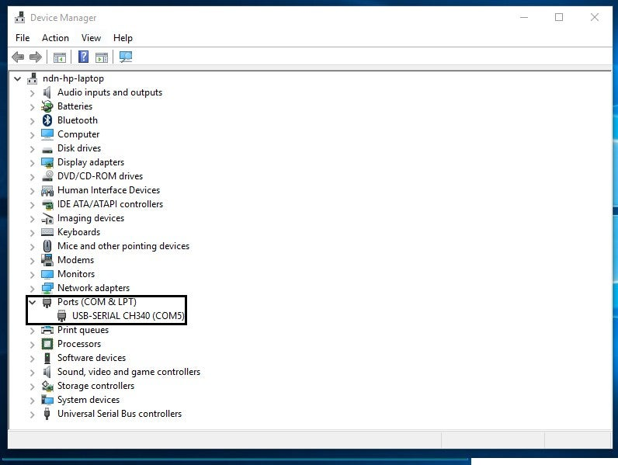
BOARD INSTALLATION PROCESS

Slide 15


Presented by
Sathish Sarathy

